Slide 1
Web-based NemoLib Application
Emily, Yangxiao

Slide 2
Introduction
For this project, we are to design a web application to detect the network motif with user provided data. The result will include graph label, relative frequency, random mean frequency, Z score, P value, and nemo profile.

Slide 3
Background
Network Motif
NemoLib
Angular
Spring

Slide 4
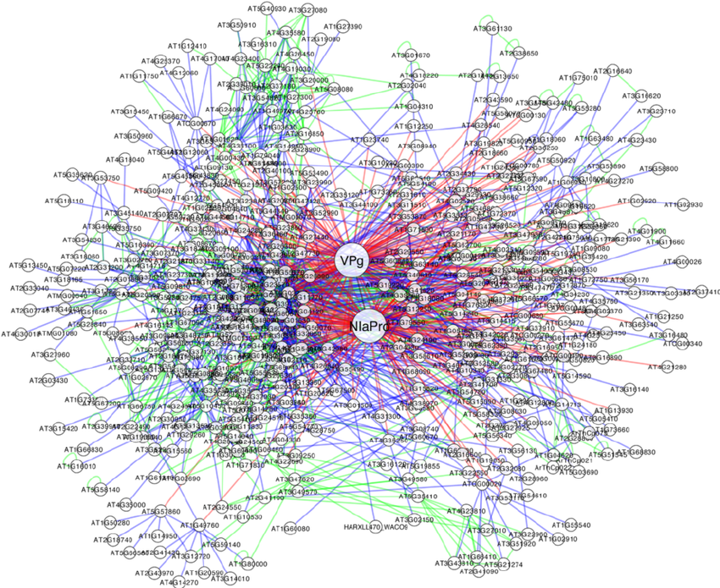
Network Motif
A network motif is a subgraph pattern that is statistically frequent in a network.
A biological network motif is a network motif found in biological networks.
In biological networks,
nodes = molecules
edges = interactions between molecules
[1]

Slide 5
Search Network Motif
Network-based
Given a network, find all non-isomorphic k-node of subgraph and get frequency of each subgraph
Generate a number of random graphs and repeat a
Find motif using Z-score and/or P-value
Motif-based
List all or some non-isomorphic k-node of subgraphs
Get the frequency of each subgraph in a given network
Generate a number of random graphs and repeat a and b
Find motif using Z-score and/or P-value

Slide 6
Network-based Motif Search
ESU algorithm [2]

Slide 7
NemoLib Library
A library for searching network motif
Implement motif finding using the network-based approach - > ESU algorithm
A total of 19 classes
TargetGraphAnalyzer
RandomtGraphAnalyzer
RelativeFrequencyAnalyzer

Slide 8

Angular
A TypeScrip-based web application framework
We used an Angular project for the front-end part of the application

Slide 9

Spring

Slide 10
Motivation
In this class, we used many online and offline bioinformatics applications to help us process data and generate results.
We noticed there are some limitations of those offline applications.
Fanmod
Different OS needs different implementation
Labelg
Cannot run without C compiler

Slide 11
Advantages of web application
Accessibility
Web system are accessible anytime, anywhere through PC/Smart Phone with Internet connection.
Maintainability
Web apps are easy to maintain. When bugs are found, developer can fix it on the server side and update the server. User does not need to download new version
Extensibility
Well built web apps are often easy to modify or add new features.

Slide 12
Purpose and Goals
As smartphone and laptop become ubiquitous, traditional desktop application become less popular, we decided to create a web application with NemoLib API.
By the end of the project we hope to become familiar in NemoLib as well as web development in general. We also want to be able to deliver a fully functioning application that meets all of the requirements, and we want to meet those requirements on a timely basis.
By working as a team we hope to gain experience in teamwork, communication, and knowledge sharing.

Slide 13
Requirements
Functional Requirements:
User can use the application with any web browser
User can use the application to get network motif
User can use the application to get nemo profile
Non-Functional Requirements:
The returned results should be clean and easy to understand
The running time should be reasonably fast based on the size of input data

Slide 14
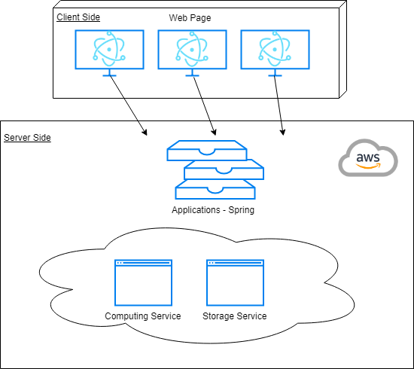
Descriptive architecture

Slide 15
Timeline
Date | Tasks | Description
Week 6 | Project plan, resources, and dependencies | Learn and evaluate the NemoLib API.
Week 7 | Framework design and implementation | Decide which functions will be included in the app. Design and implement the framework for the app. We can also create a uses case if time allows
Week 8 | Finish the framework, and deploy the functions
Week 9 | Test and polish
Week 10 | Presentation

Slide 16
Implementation

Slide 17
Demo

Slide 18
Bibliography
Martínez, Fernando & Rodrigo, Guillermo & Aragonés, Verónica & Ruiz Valdés, Marta & Lodewijk, Iris & Fernández, Unai & Elena, Santiago & Daròs, José-Antonio. (2016). Interaction network of tobacco etch potyvirus NIa protein with the host proteome during infection. BMC Genomics. 17. 10.1186/s12864-016-2394-y.
S. Wernicke, “Efficient Detection of Network Motifs,” IEEE/ACM Transactions on Computational Biology and Bioinformatics, vol. 3, no. 4, pp. 347–359, Oct. 2006.

Slide 19
Questions?
Thank you!

